Slide 1
Natural Language Processing

Slide 2
What is NLP?
Examples of NLP
text messages, news clips, social media on your phone
TV programs
conversations
hearing-impaired / sight-impaired
emails
driving and observing signs
language translation
Siri

Slide 3
What is NLP?
processing various forms of communication and deriving useful information
performed on text collection known as corpus
plural – corpora
Nuances, context and personal views affect how natural language is processed. Ex. “What did she mean by that post?”
Search engines get to “know you” through prior search history.
Advantage – better search results
Disadvantage – invasion of privacy

Slide 4
TextBlob
object-oriented NLP text-processing library
built on the NLTK (natural language toolkit) and pattern NLP libraries
Tokenization - splitting text into pieces called tokens, which are meaningful units, such as words and numbers.
Parts-of-speech (POS) tagging
Noun phrase extraction
Sentiment analysis
Inter-language translation and language detection
Inflection - pluralizing and singularizing words
Word frequencies - determining how often each word appears in a corpus.
WordNet integration - for finding word definitions, synonyms and antonyms.

Slide 5
Install TextBlob
create virtual environment in VS code - nlp_venv
activate nlp_venv
install module – pip install textblob
install NLTK corpora used by textblob – py –m textblob.download_corpora

Slide 6
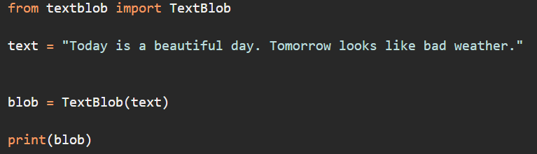
NLP processing
create a new file named – nlp_1.py
Code:

Slide 7
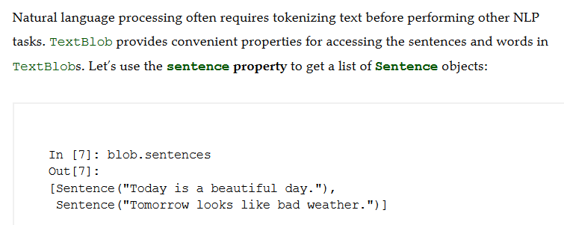
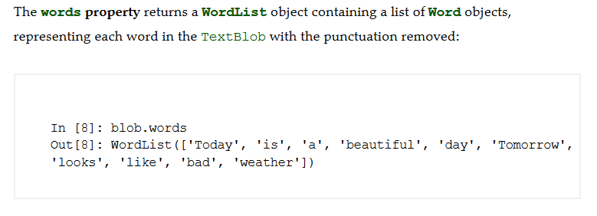
Sentences and Words

Slide 8
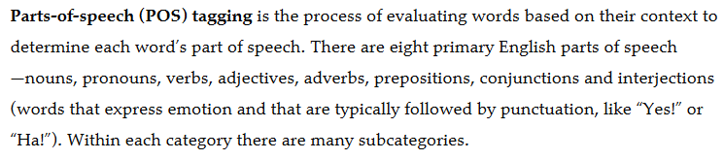
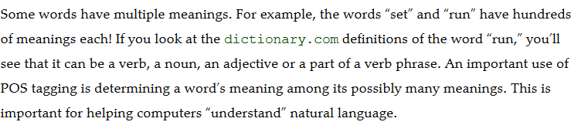
Parts-of-Speech Tagging

Slide 9
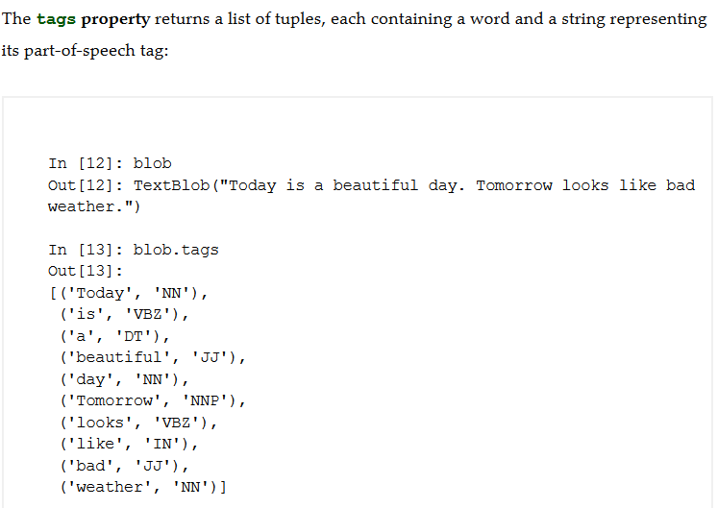
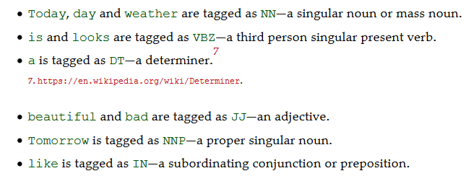
Parts-of-Speech Tagging

Slide 10
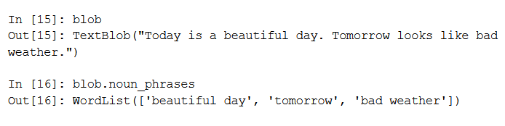
Parts-of-Speech Tagging
Extracting noun phrases returns a wordlist – a list of word objects

Slide 11
Sentiment Analysis
One of the most common and valuable NLP tasks is sentiment analysis, which determines whether text is positive, neutral or negative.
Consider the positive word “good” and the negative word “bad.” Just because a sentence contains “good” or “bad” does not mean the sentence’s sentiment necessarily is positive or negative.
Example – “The food is not good.” or “The movie was not bad.”
Sentiment analysis is a complex machine-learning problem. However, libraries like TextBlob have pretrained machine learning models for performing sentiment analysis.

Slide 12
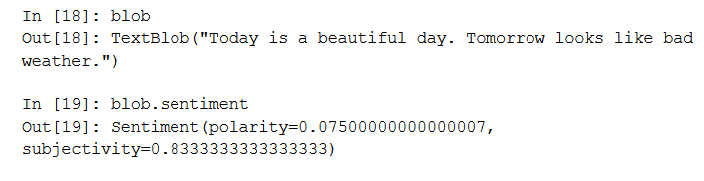
Sentiment Analysis
A TextBlob’s sentiment property returns a Sentiment object indicating whether the text is positive or negative and whether it’s objective or subjective:
polarity indicates sentiment from -1.0 (-ve) to 1.0 (+ve)
Subjectivity is from 0.0 (objective) to 1.0 (subjective)

Slide 13
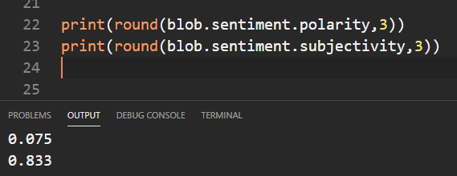
Sentiment Analysis
we can get each value separately and round it off for less precision

Slide 14
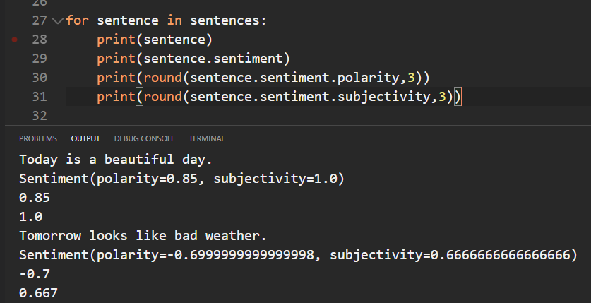
Sentiment Analysis
We can get the sentiment of individual sentences in a textblob at the sentence level.

Slide 15
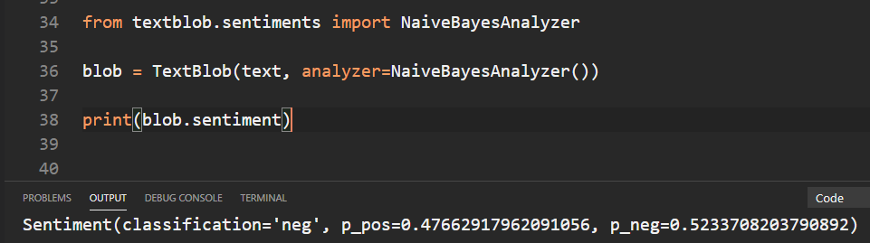
Sentiment Analysis – using NaiveBayesAnalyzer
By default, a TextBlob and the Sentences and Words you get from it determine sentiment using a PatternAnalyzer
The TextBlob library also comes with a NaiveBayesAnalyzer which was trained on a database of movie reviews.
overall sentiment is classified as negative.
p_pos indicates that the TextBlob is 47.66% positive, and its p_neg indicates that the TextBlob is 52.34% negative.
Since the overall sentiment is just slightly more negative we’d probably view this TextBlob’s sentiment as neutral overall.

Slide 16
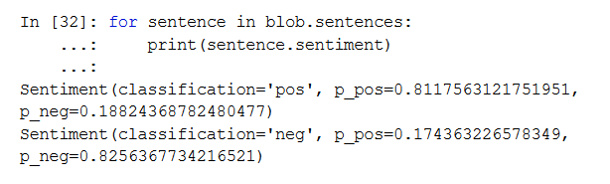
Sentiment Analysis
do the same at the sentence level

Slide 17
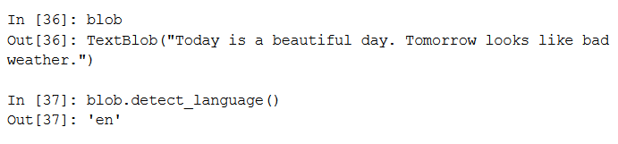
Language Detection and Translation
The TextBlob library uses Google Translate to detect a text’s language and translate TextBlobs, Sentences and Words into other languages.
use detect_language method to detect the language of the text we’re manipulating

Slide 18
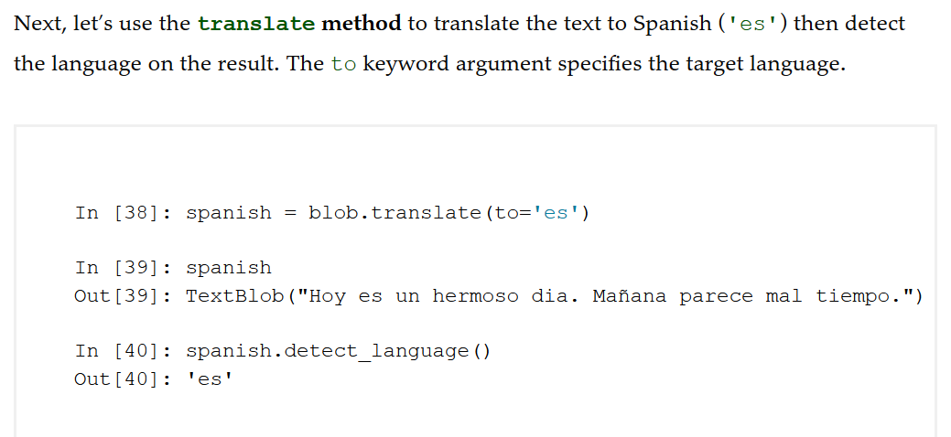
Language Detection and Translation

Slide 19
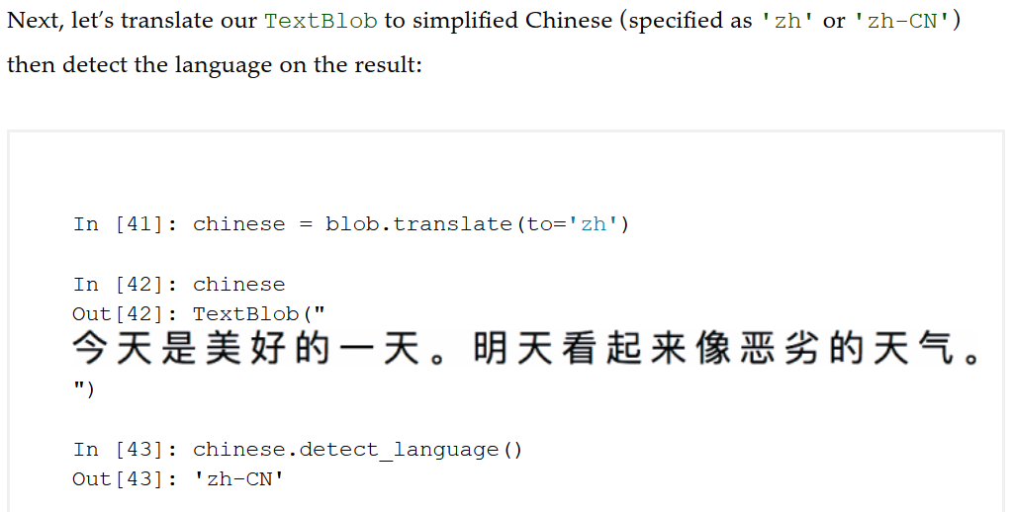
Language Detection and Translation

Slide 20
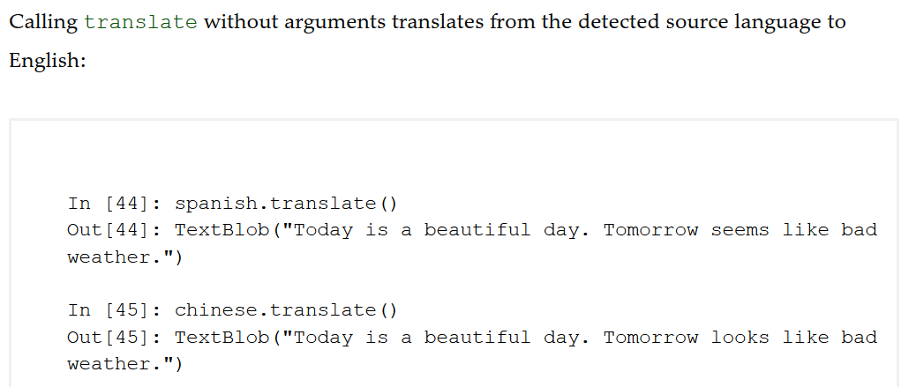
Language Detection and Translation

Slide 21
Inflection: Pluralization and Singularization
Inflections are different forms of the same words, such as singular and plural (like “person” and “people”) and different verb tenses (like “run” and “ran”).
When you’re calculating word frequencies, you might first want to convert all inflected words to the same form for more accurate word frequencies.
Words and WordLists each support converting words to their singular or plural forms.

Slide 22
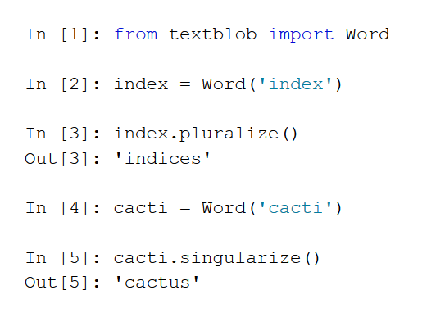
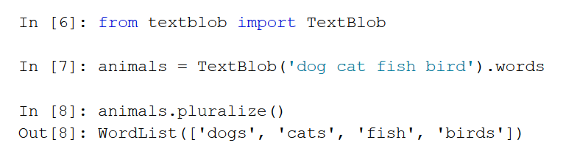
Inflection: Pluralization and Singularization
Words
Word List

Slide 23
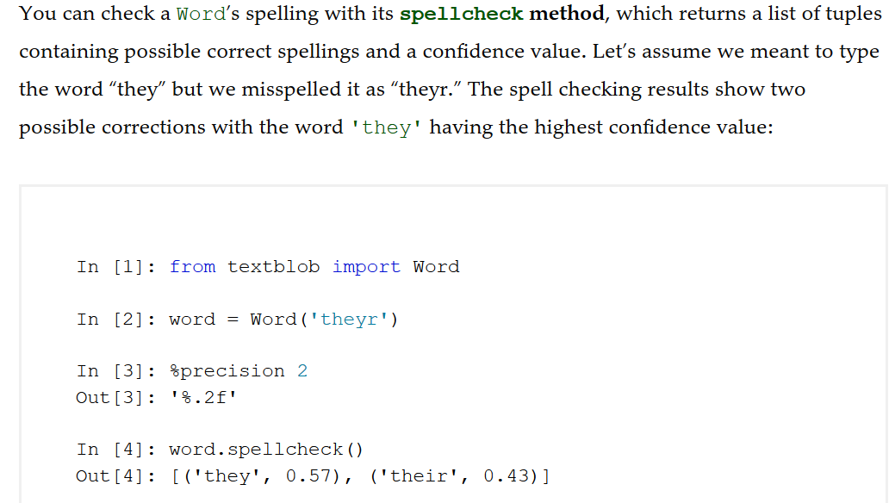
Spellcheck an Correction

Slide 24
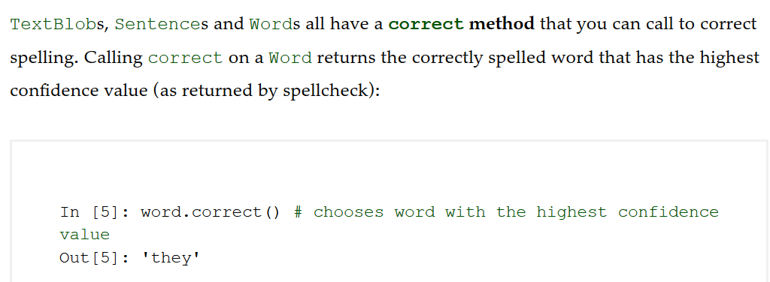
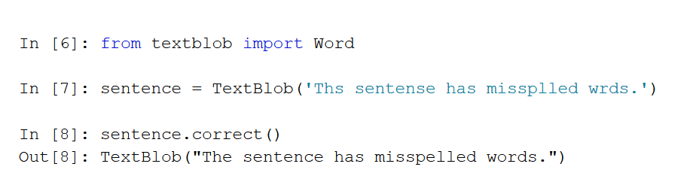
Spellcheck and Correction

Slide 25
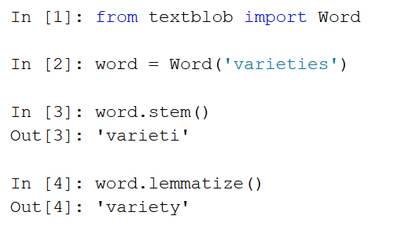
Normalization: Stemming and Lemmatization
Stemming and lemmatization are normalization operations, in which you prepare words for analysis.
before calculating statistics on words in a body of text, you might convert all words to lowercase so that capitalized and lowercase words are not treated differently
you might want to treat all of the following words as “program”: program, programs, programmer, programming and programmed

Slide 26
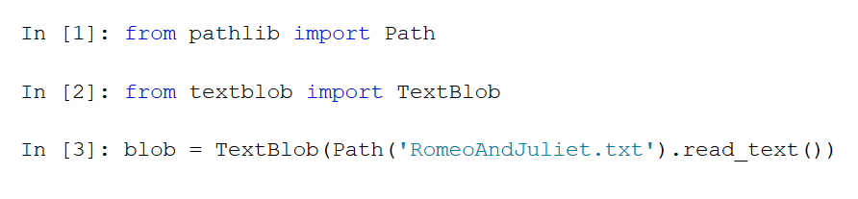
Word Frequencies
Load the e-book for Shakespeare’s Romeo and Juliet into a TextBlob.
To do so, we’ll use the Path class from the Python Standard Library’s pathlib module:

Slide 27
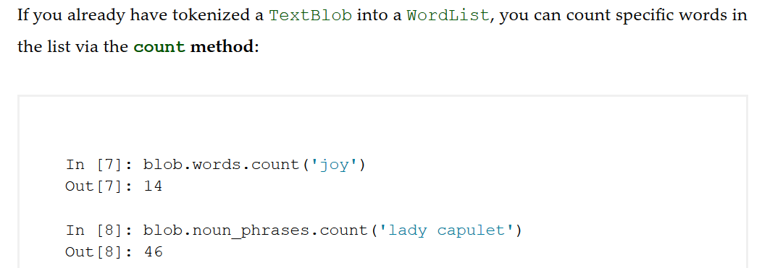
Word Frequencies

Slide 28
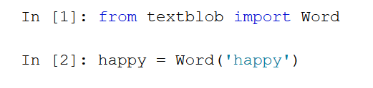
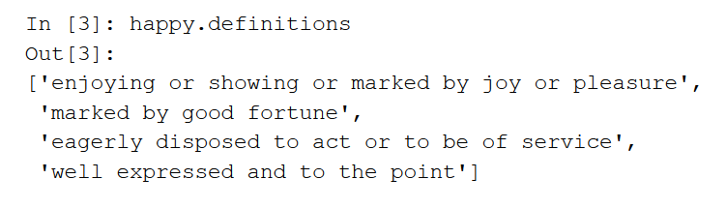
Definitions, Synonyms and Antonyms from WordNet
WordNet19 is a word database created by Princeton University.
The TextBlob library uses the NLTK library’s WordNet interface, enabling you to look up word definitions, and get synonyms and antonyms.

Slide 29
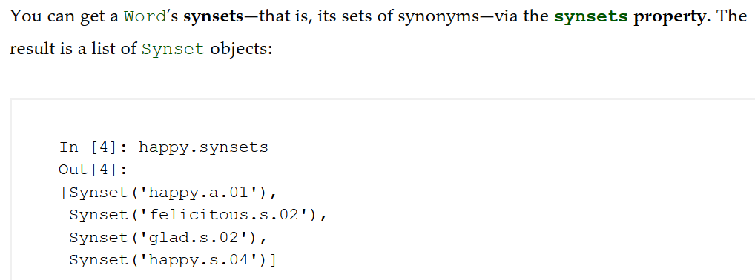
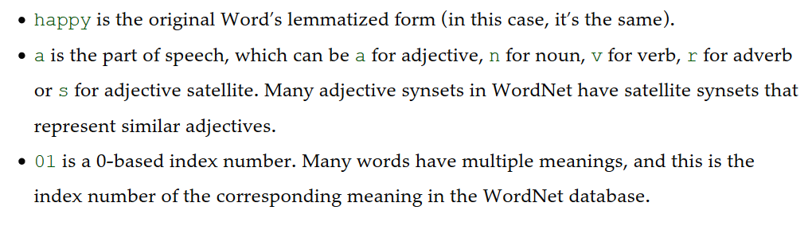
Getting Synonyms

Slide 30
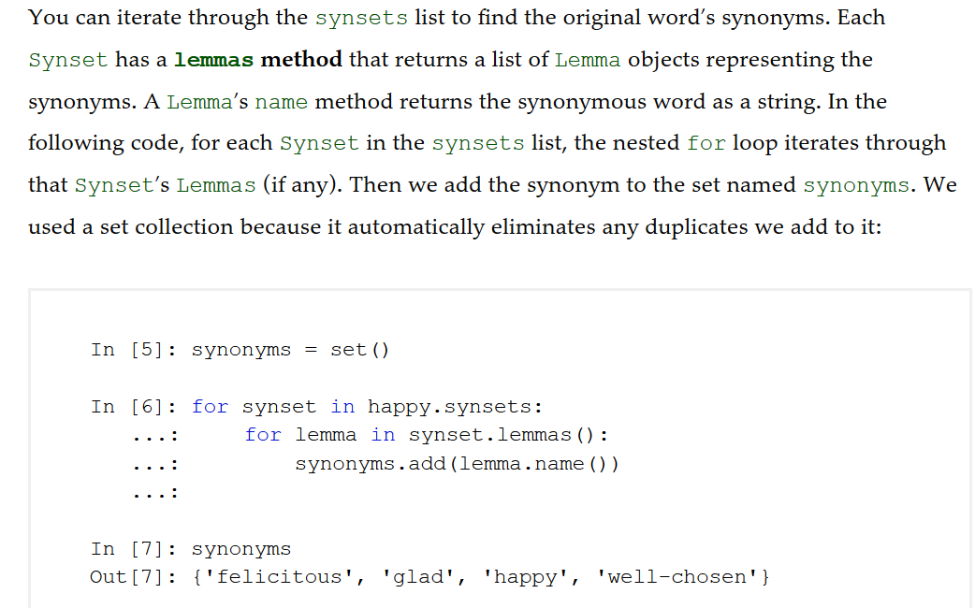
Getting Synonyms

Slide 31
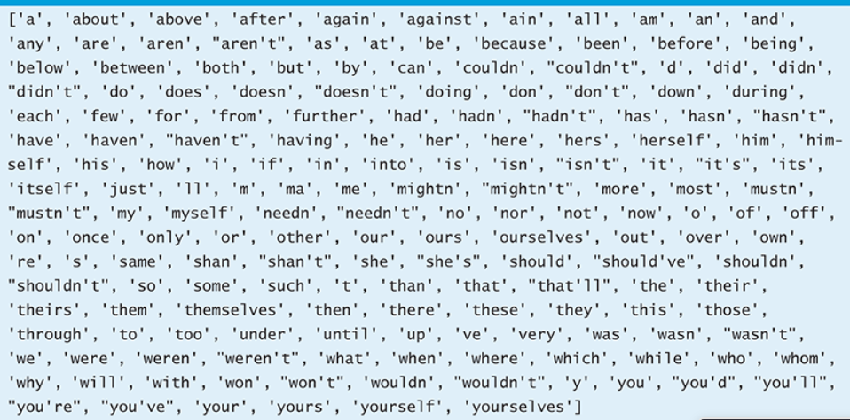
Deleting Stop Words
Stop words are common words in text that are often removed from text before analyzing it because they typically do not provide useful information.

Slide 32
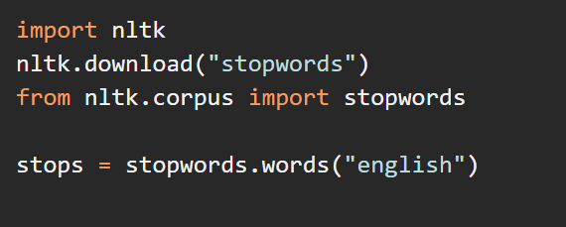
Deleting Stop Words

Slide 33
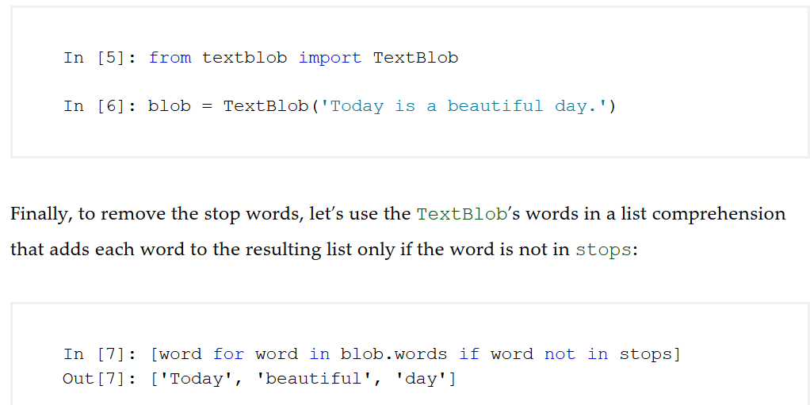
Deleting Stop Words

Slide 34
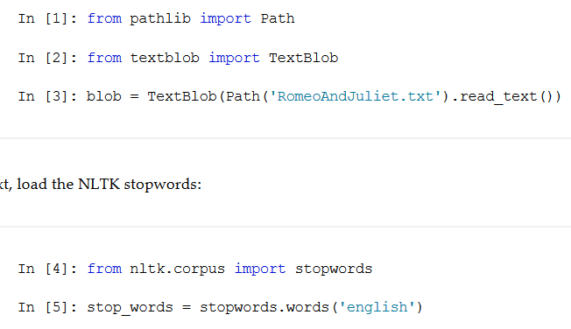
Visualizing Word Frequencies with Pandas
Let’s try and visualize the top 20 words that are in the text of Romeo and Juliet

Slide 35
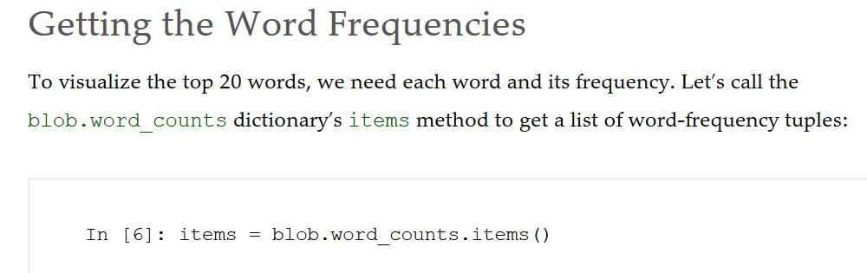
Eliminate the stop words

Slide 36
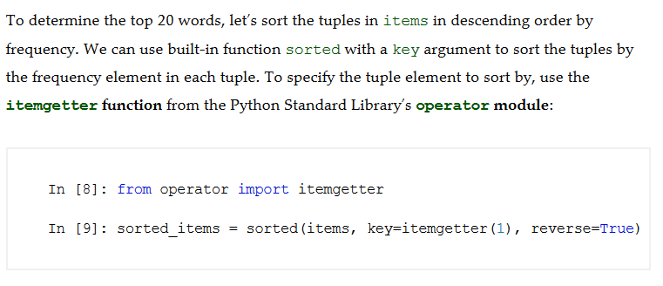
Sorting the Words by Frequency

Slide 37
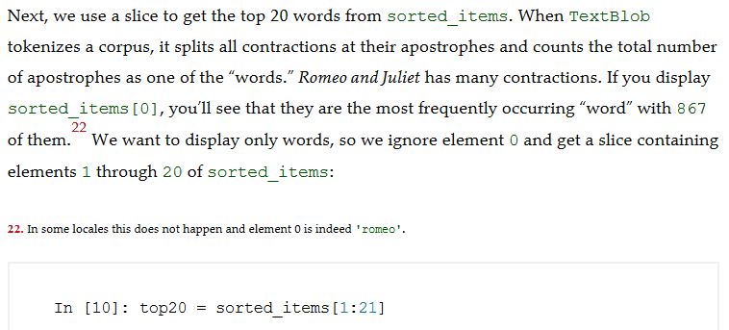
Getting the Top 20 Words

Slide 38
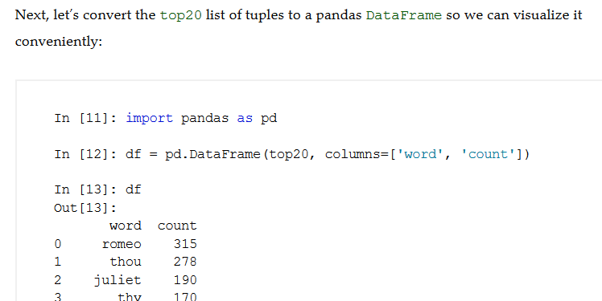
Convert top20 to a DataFrame

Slide 39
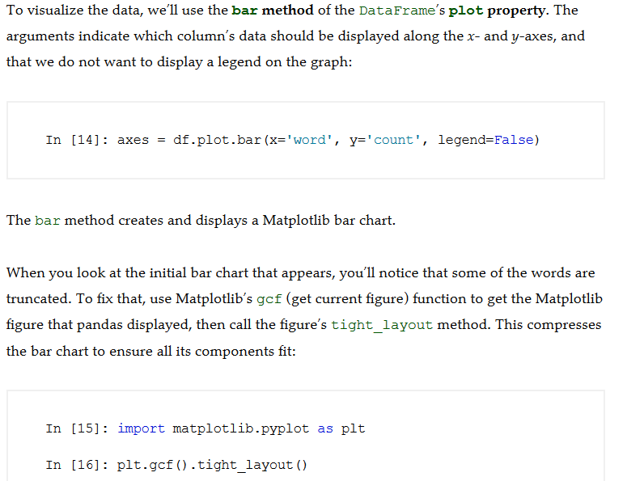
Visualizing the DataFrame

Slide 40
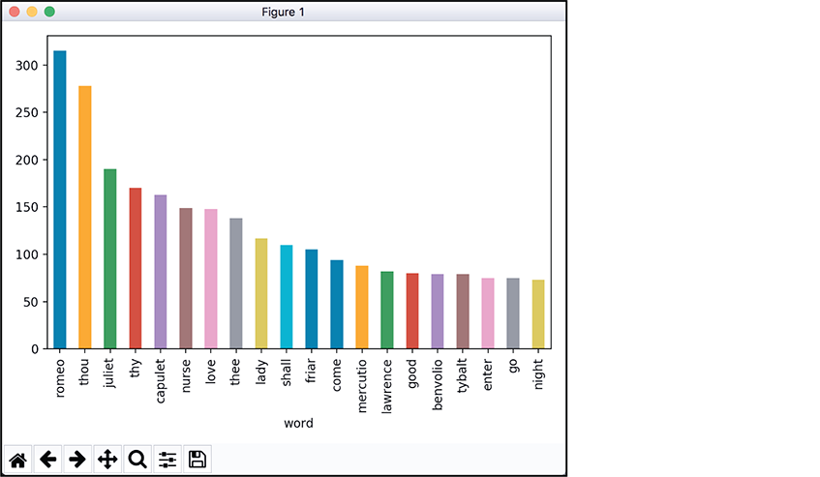
Visualizing the DataFrame

Slide 41
Visualizing Word Frequencies with Word Clouds
You can use the open source wordcloud module’s WordCloud class to generate word clouds with just a few lines of code.
By default, wordcloud creates rectangular word clouds, but as you’ll see the library can create word clouds with arbitrary shapes.
Install the wordcloud and imageio modules:
pip install wordcloud
pip install imageio

Slide 42
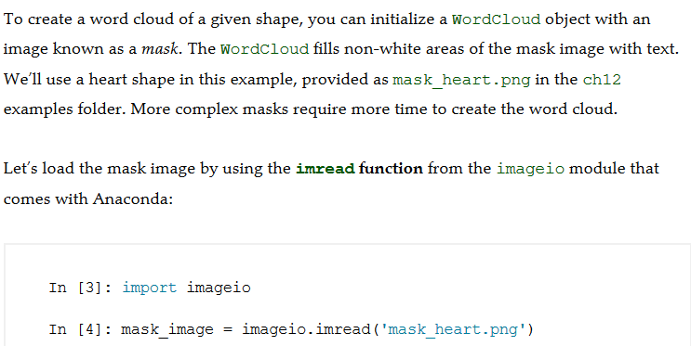

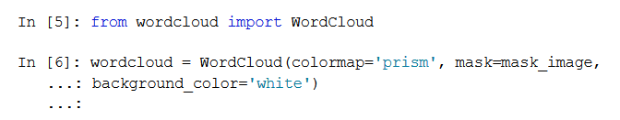
Loading the Mask Image that Specifies the Word Cloud’s Shape

Slide 43
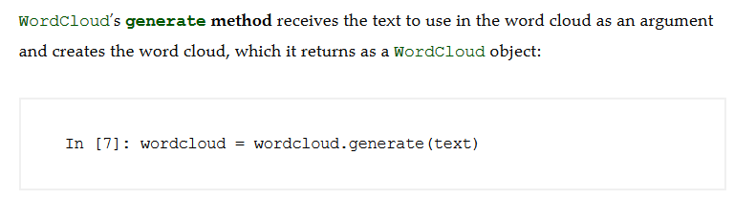

Generate and Save the Word Cloud

Slide 44
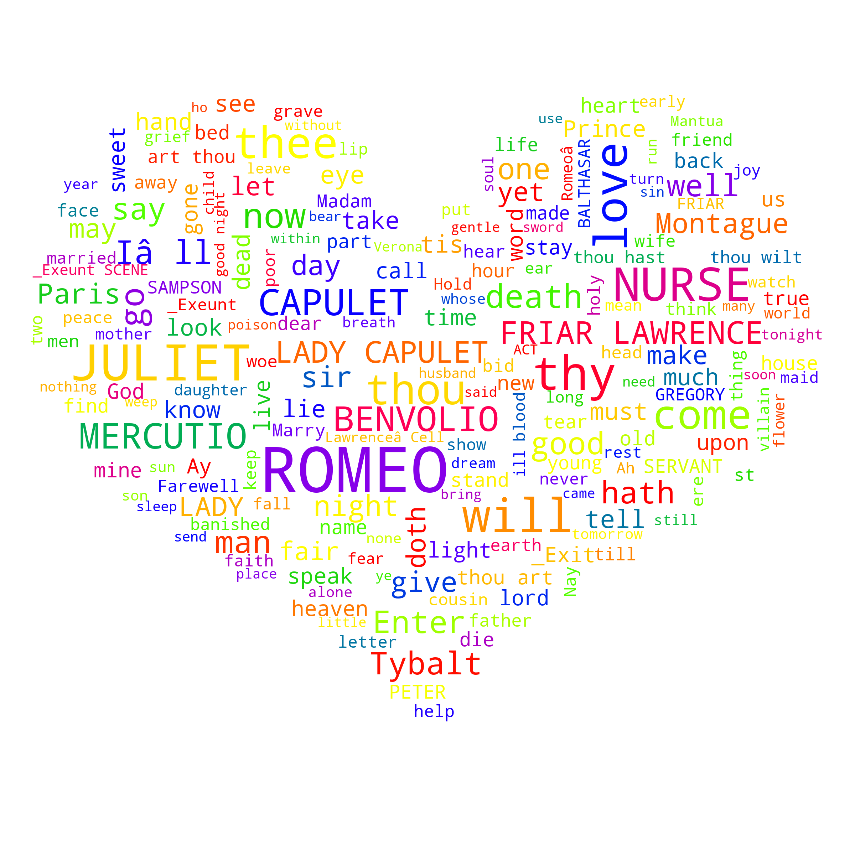
WordCloud

Slide 45
Named Entity Recognition with spaCy
NLP can determine what a text is about. A key aspect of this is named entity recognition, which attempts to locate and categorize items like dates, times, quantities, places, people, things, organizations and more.

Slide 46
Install spaCy
Make sure your VE is activated
pip install spacy
py –m spacy download en
NOTE: the above command may give you a warning about not being able to install the shortcut. It is not an issue, we just have to change the code slightly

Slide 47
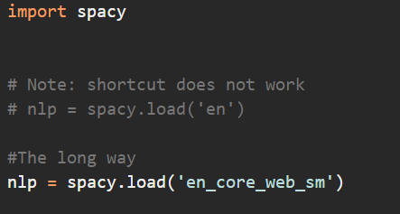
Loading the Language Model
The first step in using spaCy is to load the language model representing the natural language of the text you’re analyzing. To do this, you’ll call the spacy module’s load function. Let’s load the English model that we downloaded above:

Slide 48
Creating a spaCy Doc
Next, you use the nlp object to create a spaCy Doc object33 representing the document to process. Here we used a sentence from the introduction to the World Wide Web

Slide 49

Getting the Named Entities
The Doc object’s ents property returns a tuple of Span objects representing the named entities found in the Doc. Each Span has many properties. Let’s iterate through the Spans and display the text and label_ properties:
Each Span’s text property returns the entity as a string, and the label_property returns a string indicating the entity’s kind. Here, spaCy found three entities representing a DATE (1994), a PERSON (Tim Berners-Lee) and an ORG (organization; the World Wide Web Consortium).

Slide 50
You Try
Display the named entities in 'Paul J. Deitel is CEO of Deitel & Associates, Inc.'

Slide 51
Similarity Detection with spaCy
Similarity detection is the process of analyzing documents to determine how alike they are. One possible similarity detection technique is word frequency counting. For example, some people believe that the works of William Shakespeare actually might have been written by Sir Francis Bacon, Christopher Marlowe or others. Comparing the word frequencies of their works with those of Shakespeare can reveal writing-style similarities.

Slide 52
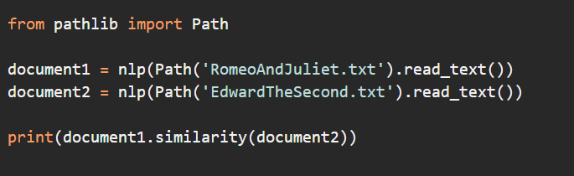

Comparing the Books’ Similarity
As you can see, spaCy believes these two documents have significant similarities. For comparison purposes, we can create another Doc representing a current news story and compared it with Romeo and Juliet. How similar is it?

